Slide 1


Case #2
Daily CSI
Can you solve it?
Trash Tosser
8th Grade Forensic Science
T. Trimpe 2006 http://sciencespot.net/

Slide 2
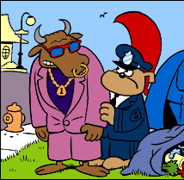
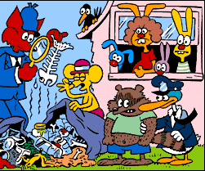
An inconsiderate slob dumped trash on Rachel Rabbit's lawn.
One of these two suspects is guilty. Slylock Fox found
evidence that may identify the loathsome litterbug.
What did Slylock observe to help him identify the trash tosser?
Hint: Notice the bones in the trash.
Source: http://www.slylockfox.com/arcade/BrainBogglers/index.html

Slide 3
Solution
Slylock found bones in the trash.
The bull is an herbivore and only eats plants.
The raccoon is an omnivore and eats both plants and animals. The raccoon is the trash tosser.

